Slide 1

Explicit Tradeoffs between Adversarial and Natural Distributional Robustness
Nahal Mirzaie, Amir Ezzati

Slide 2
Natural Distributional Robustness
Ensuring models rely on core features (causal) rather than spurious features (correlated but non-causal)
Spurious features are features that only hold in specific training distributions but broken under others.
Core features are causal features that remain predictive across all distributions.

Slide 3
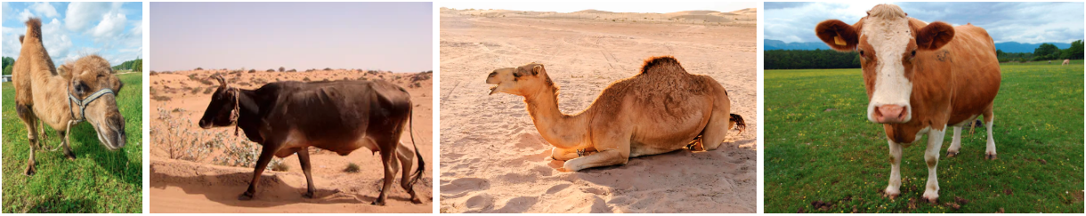
Train Distribution
Test Distribution
Background as a shortcut in Camel-Cow classification task

Slide 4

Adversarial Robustness
Robustness to adversarial examples, slight perturbations within the data distribution.

Slide 5
Reliable Models
Should have natural distributional robustness
Do not rely on spurious features for predictions
Should be robust against adversarial examples
Have the lowest error on adversarial examples
Can a single model achieve both types of robustness simultaneously? Specifically, are the optimal parameters for adversarial robustness the same as those required for natural distributional robustness?

Slide 6
Paper Organization
Theoretical Evidence:
In a linear regression model, it has been proven that the parameters ensuring adversarial robustness differ from those ensuring natural distributional robustness, which avoids reliance on spurious features.
Empirical Evidence:
In two setups 1) linear models on mock dataset, and 2) deep models on real datasets it has been shown:
(Effect) Adversarial training reduces core and increases background reliances
(Reverse Effect) Presence of Spurious Correlations Improves Adversarial Robustness

Slide 7
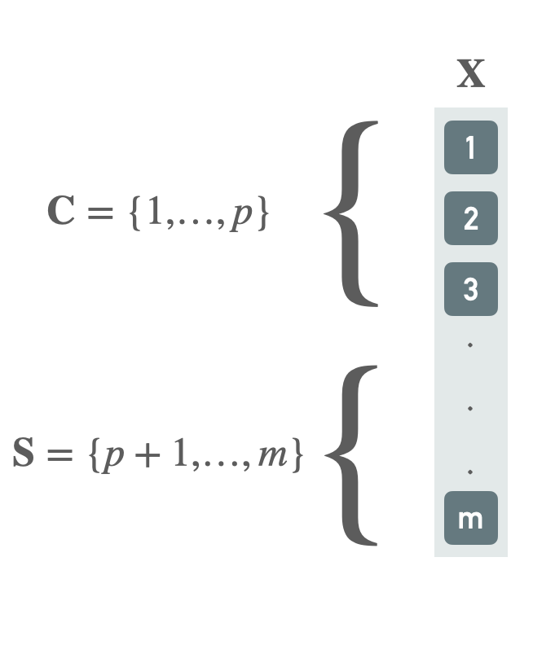
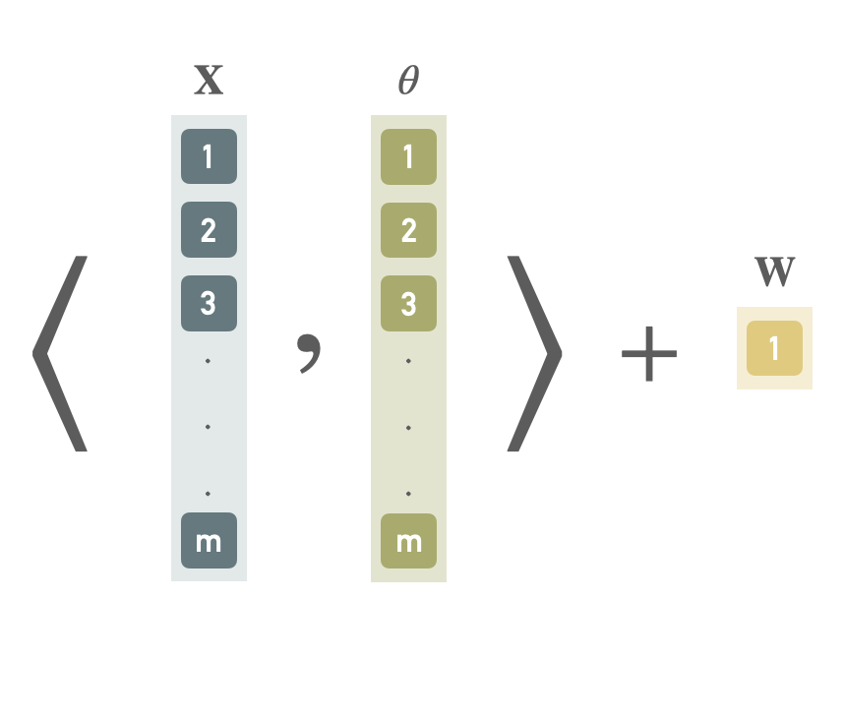
Theoretical Evidence
$$X∈R^{m}$$
$$X∼N(0,Σ)\text{where}Σ∈R^{m×m}$$
$$\text{WLOG,}X=[C,S]$$
$$Y=⟨X,θ^{opt}⟩+W$$
$$θ∈R^{m}$$
$$W∈R$$
$$W∼N(0,σ_{w}^{2})$$

Slide 8
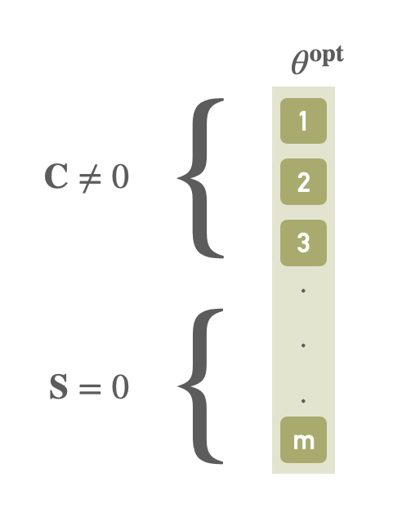
Theoretical Evidence
Optimal parameters for natural distributional robustness ($θ^{opt}$) don’t rely on spurious features
This indicates $Y⊥X_{S}∣X_{C}$

Slide 9
Theoretical Evidence
Now consider adversarial loss as follows
$$L_{p,ϵ}(θ)=E\left[max{\left(Y-⟨X+δ,θ⟩\right)}^{2}\right],∥δ∥_{p}≤ϵ$$
We first show that the inner maximization is equal to
$$max{\left(|Y-⟨X+δ,θ⟩|\right)}^{2}=max(|Y-⟨X,θ⟩|+ϵ⋅∥θ∥_{q})^{2}$$
And then we show that the adversarial loss can be written as
$$L_{p,ϵ}(θ)=c_{2}⋅σ_{θ}^{2}+{\left(c_{1}σ_{θ}+ϵ⋅∥θ∥_{q}\right)}^{2}$$
$$whereσ_{θ}^{2}=(θ-θ_{\text{opt}})^{⊤}Σ(θ-θ_{\text{opt}})+σ_{w}^{2}$$
$$andc_{1}=\sqrt{\frac{2}{π}}<1,c_{2}=1-c_{1}^{2}$$

Slide 10
Theoretical Evidence
$$|Y-⟨X+δ,θ⟩|=|Y-⟨X,θ⟩|+ϵ⋅∥θ∥_{q}$$
Proof:
$$\left|Y-⟨X+δ,θ⟩\right|≤\left|Y-⟨X,θ⟩\right|+\left|⟨δ,θ⟩\right|$$
$$\left|Y-⟨X+δ,θ⟩\right|≤\left|Y-⟨X,θ⟩\right|+{∥δθ∥}_{1}$$
$$\left|Y-⟨X+δ,θ⟩\right|≤\left|Y-⟨X,θ⟩\right|+{∥δ∥}_{p}{∥θ∥}_{q}$$
$$\left|Y-⟨X+δ,θ⟩\right|≤\left|Y-⟨X,θ⟩\right|+ϵ.{∥θ∥}_{q}$$
(Hölder’s inequality)
$$∥fg∥_{1}≤∥f∥_{p}∥g∥_{q}$$
$$\frac{1}{p}+\frac{1}{q}≤1$$

Slide 11
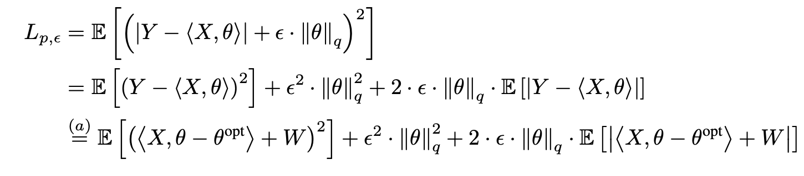
Theoretical Evidence
Remember that $L_{p,ϵ}(θ)=E\left[max{\left(Y-⟨X+δ,θ⟩\right)}^{2}\right],∥δ∥_{p}≤ϵ$
We know that $Y=⟨X,θ^{opt}⟩+W$

Slide 12
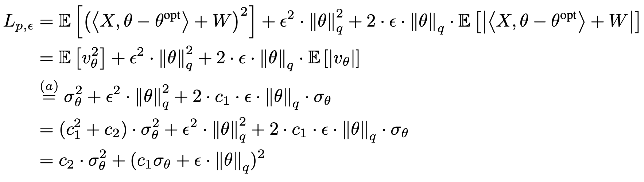
Theoretical Evidence
Define $v_{θ}$ as $⟨X,θ-θ_{\text{opt}}⟩+W$
So we can argue that $v_{θ}∼N(0,σ_{θ}^{2})$
We know $E\left[|N(0,σ^{2})|\right]=\sqrt{\frac{2}{π}}⋅σ$
($c_{1}^{2}+c_{2}=1$)

Slide 13
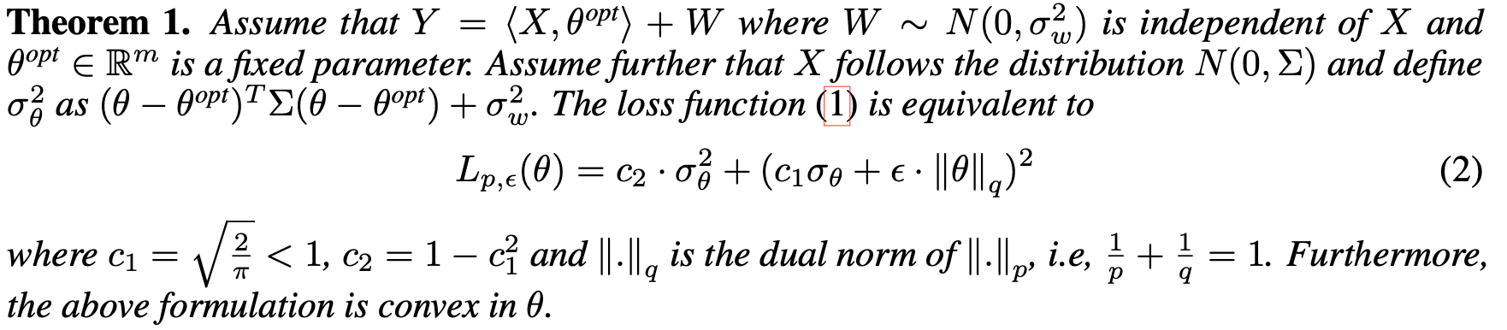
Theoretical Evidence Conclusion
Theorem 1 shows that the optimal value $\overset{̂}{θ}$ minimizing the adversarial loss $L_{p,ϵ}(θ)$ is not $θ^{opt}$ and in general , may be non-zero on the set of spurious features S.

Slide 14
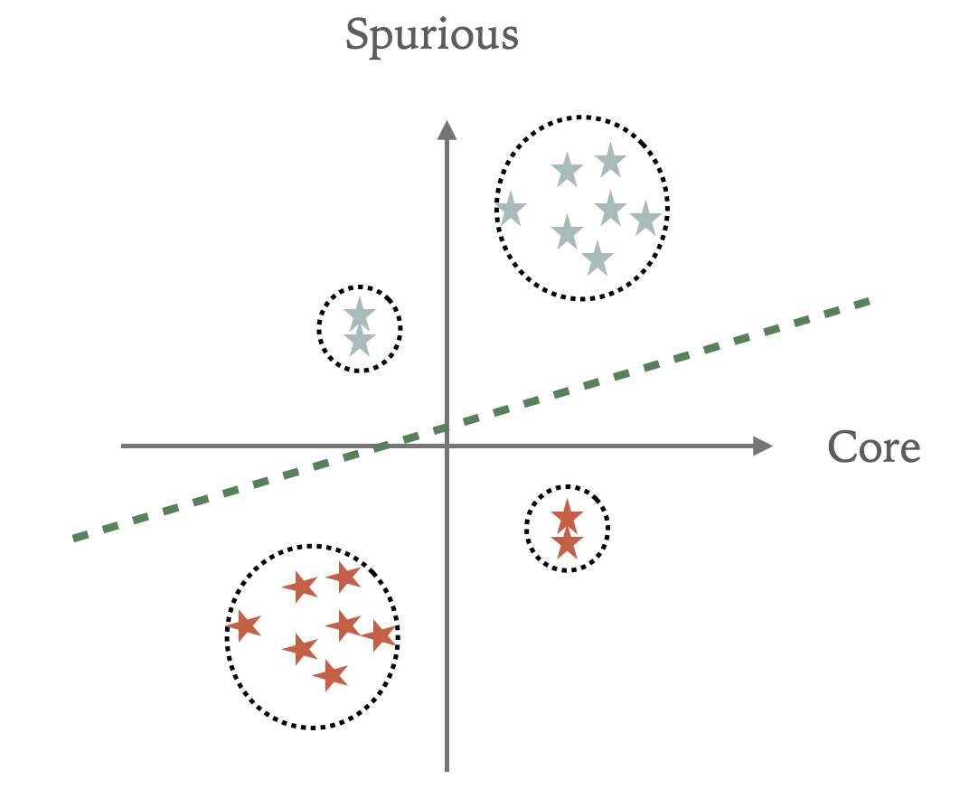
Visualization Insight
Adversarial Training promote maximizing margin

Slide 15
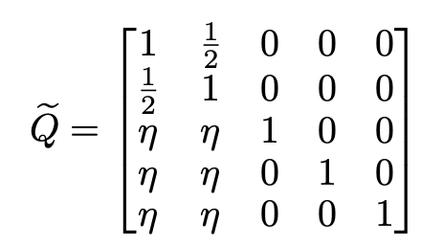
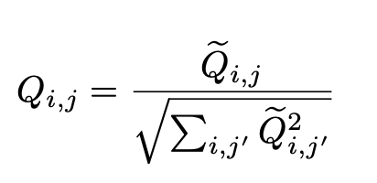
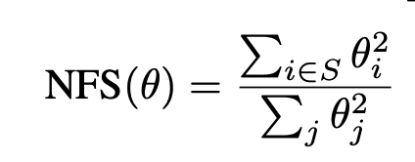
Empirical Evidence with linear models
Setup:
$$Σ=QQ^{⊤}$$
$$X∼QN(0,I)$$
$$σ_{w}=0.1$$
Metric
Norm Fraction over Spurious features

Slide 16
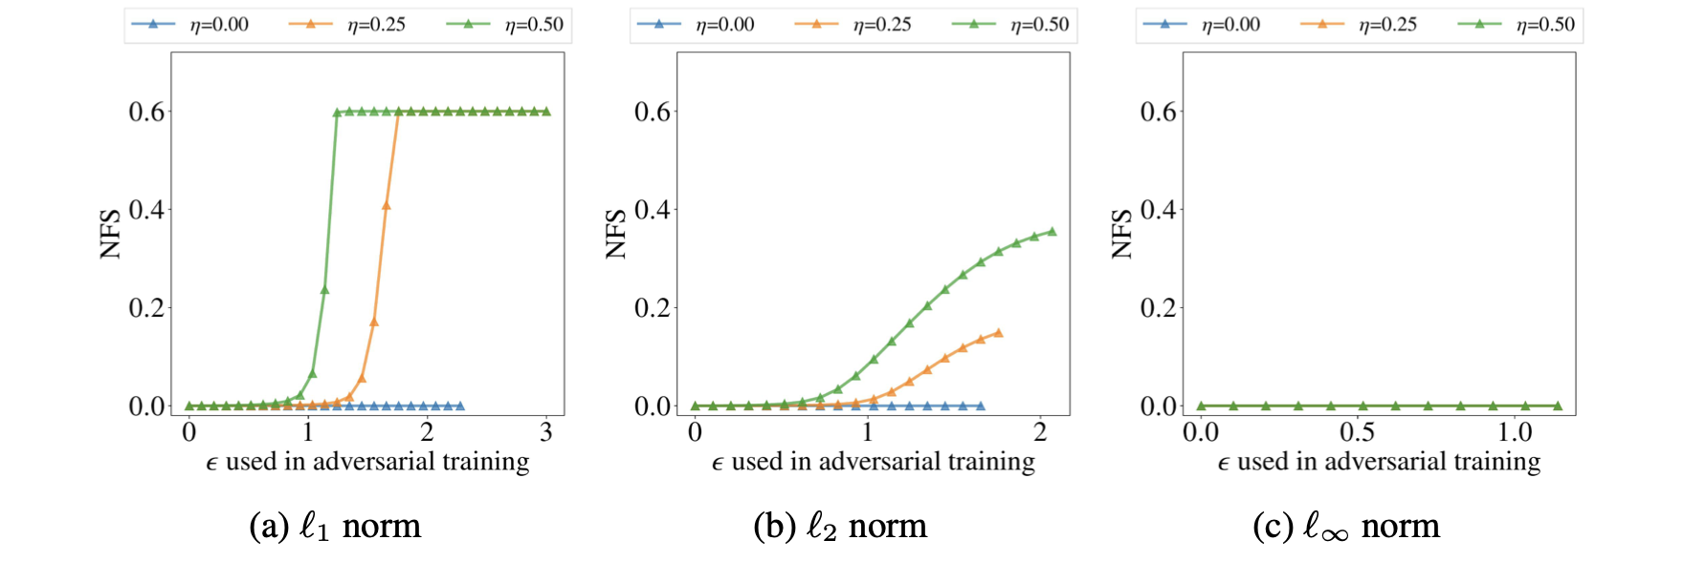
Figure 1) Reliance on Spurious features
Empirical Evidences with linear models
(Reliance on Spurious features)

Slide 17
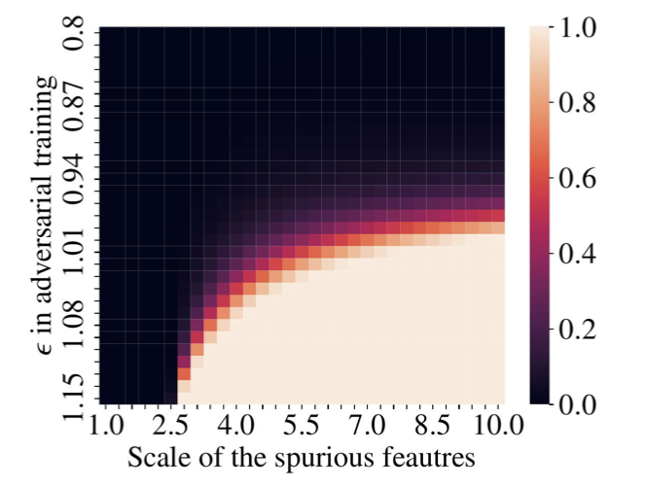
Figure 2) Effect of Scale of spurious features for $l_{∞}$
Empirical Evidences with linear models
(Scale of spurious features)

Slide 18
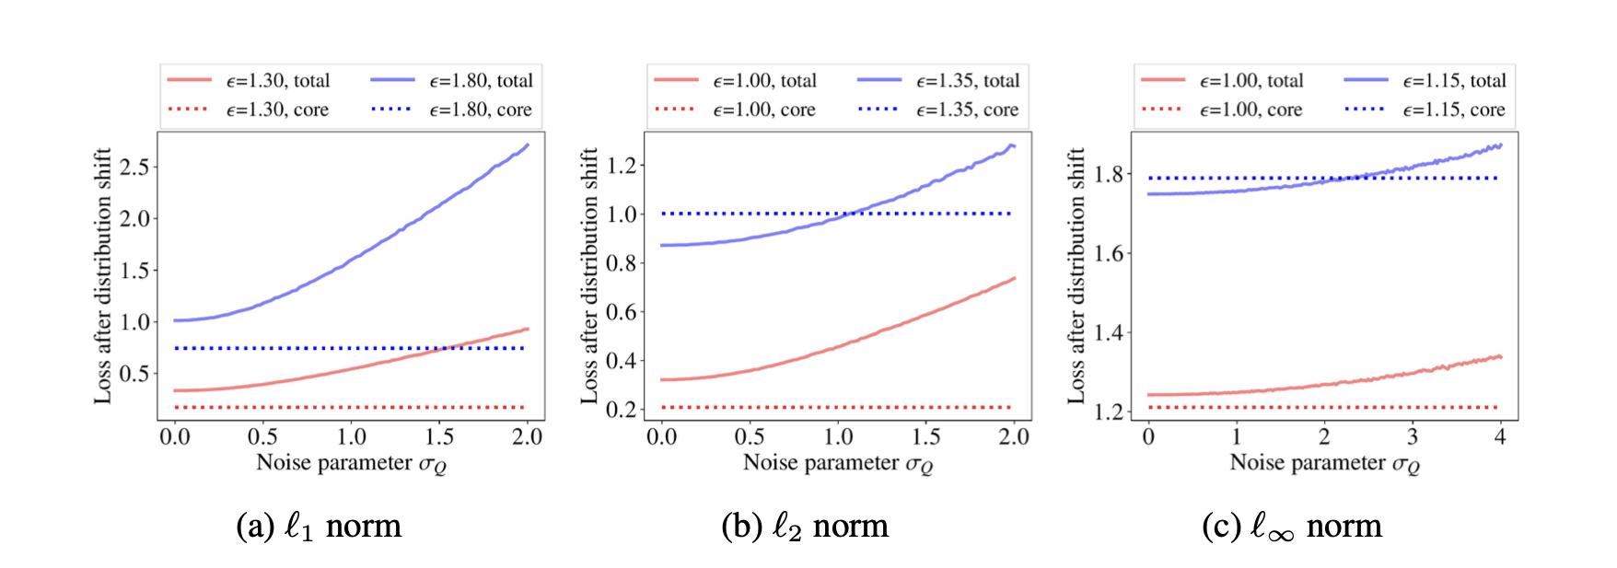
Figure 3) Effect of spurious reliance on distributional robustness
Empirical Evidences with linear models
(Effect of spurious reliance on distributional robustness)

Slide 19
Empirical Evidence with Deep models
Models
ResNet18, ResNet50
Norms
$l_{2}$, $l_{∞}$
Datasets
ImageNet-C
ObjectNet
RIVAL10
Salient ImageNet-1M
ImageNet-9
WaterBird
CIFAR10

Slide 20
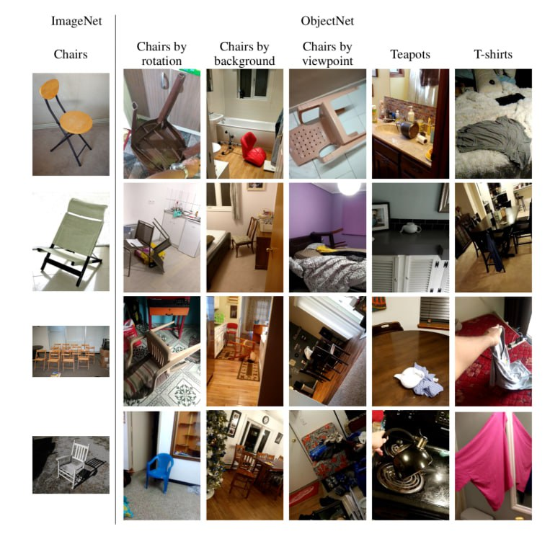
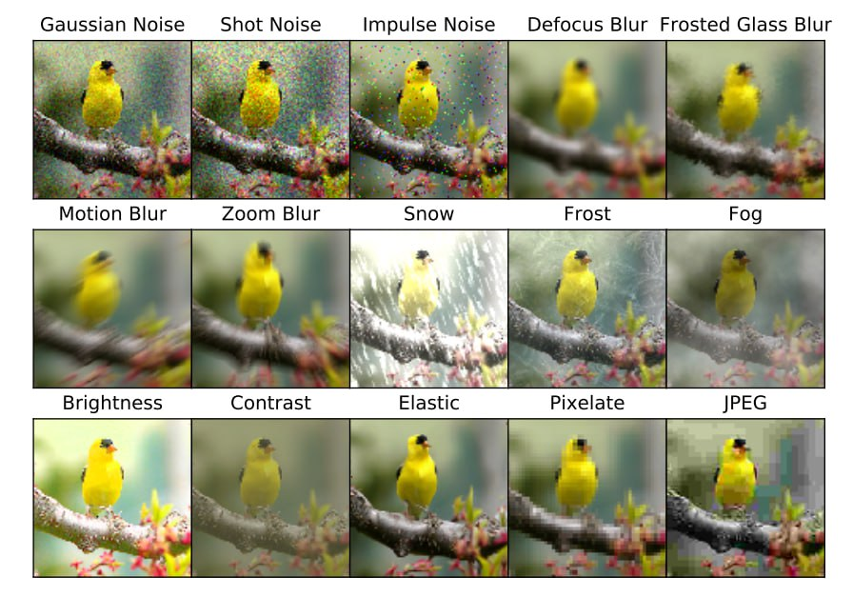
Figure 4) ObjectNet
Figure 5) ImageNet-C
ObjectNet vs ImageNet-C datasets

Slide 21
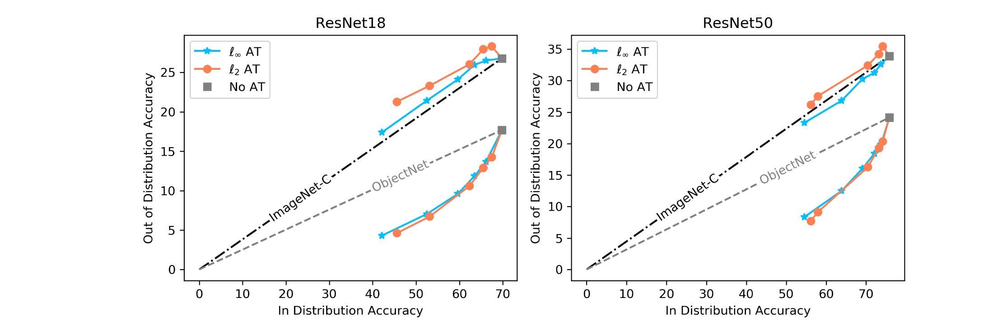
Empirical Evidence with Deep models
Adversarial Training hurts Natural Distributional Robustness only when Spurious Correlations are broken.
Figure 6) OOD accuracy vs in distribution accuracy

Slide 22
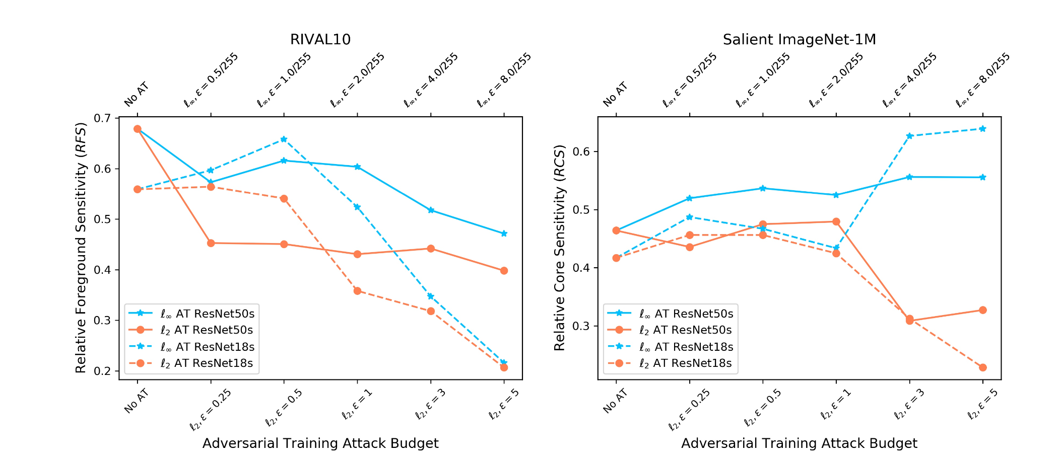
Empirical Evidence with Deep models
Reduced Core Sensitivity, and Difference in the Effect of $l_{2}andl_{∞}$Adversarial Training
Figure 7) Relative Foreground and Core sensitivity vs $ϵ$

Slide 23
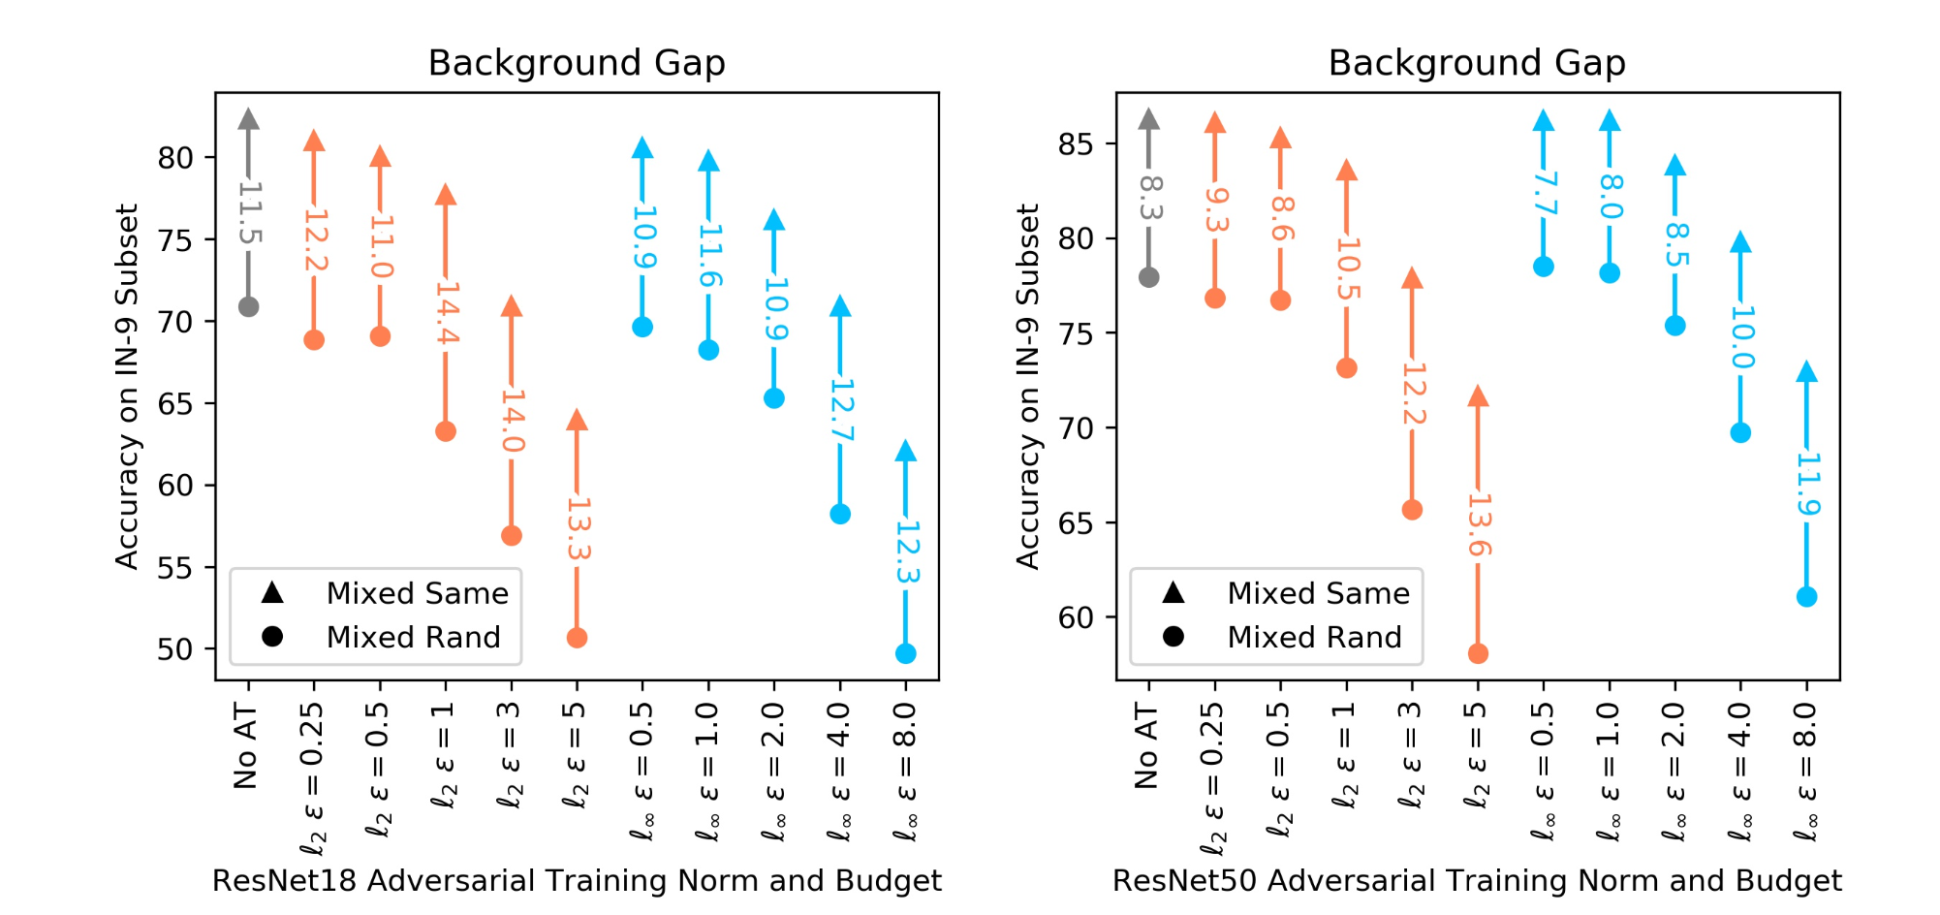
Empirical Evidence with Deep models
Adversarial Training Increases Background Reliance in Synthetic Datasets
Figure 8) Adversarial Training Increases Background Reliance

Slide 24
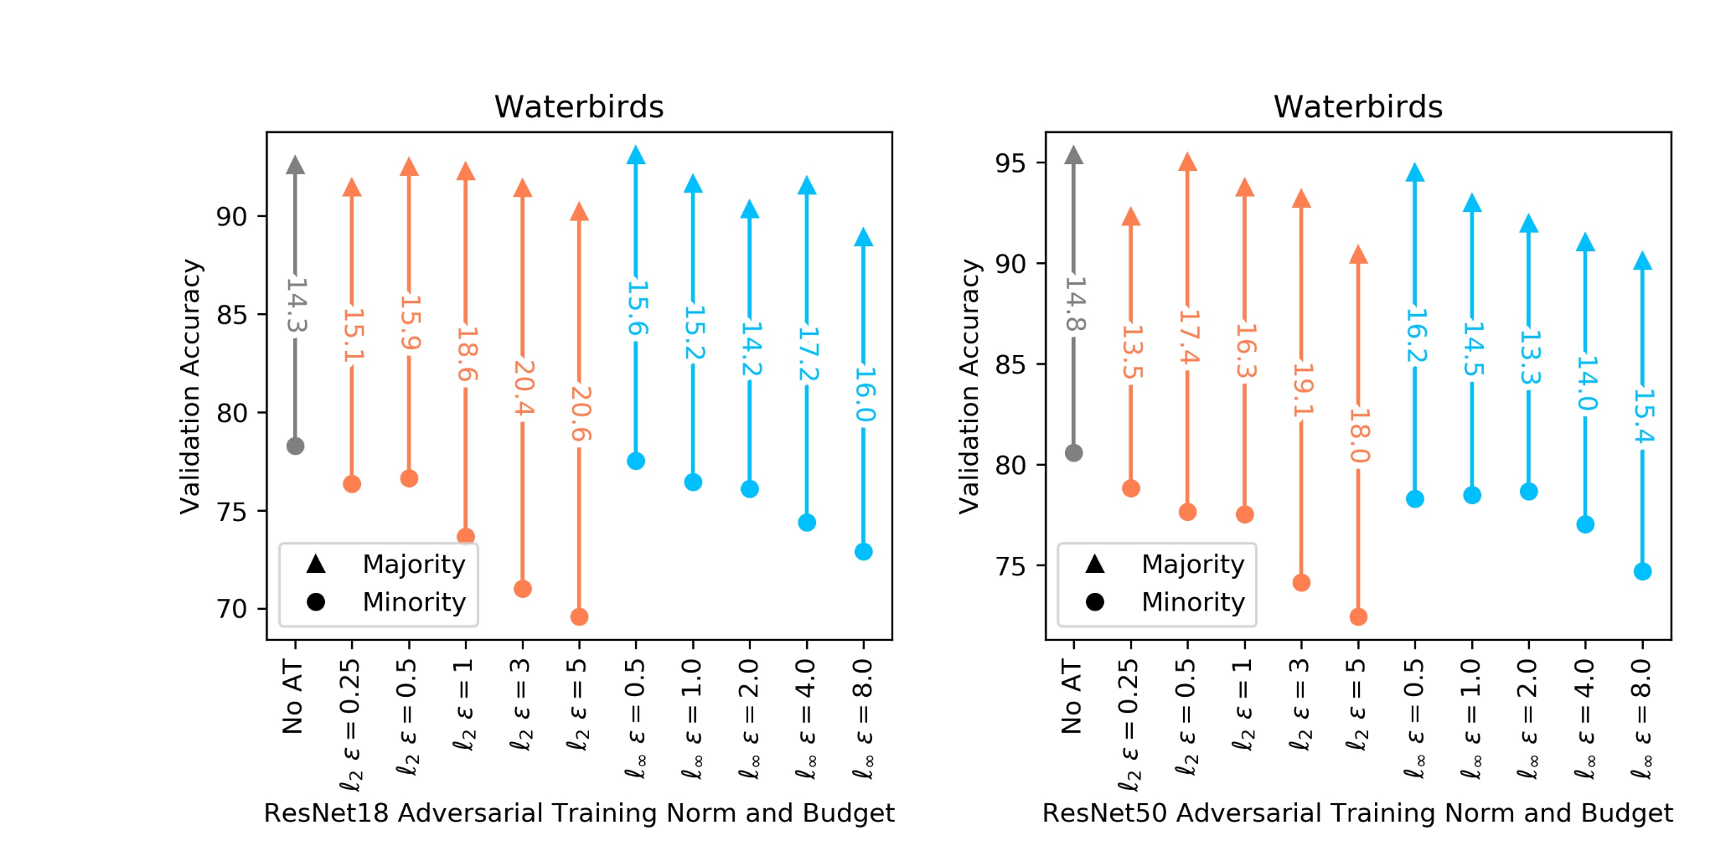
Empirical Evidence with Deep models
Adversarial Training Increases Background Reliance in Synthetic Datasets
Figure 9) Adversarial Training Increases Background Reliance

Slide 25
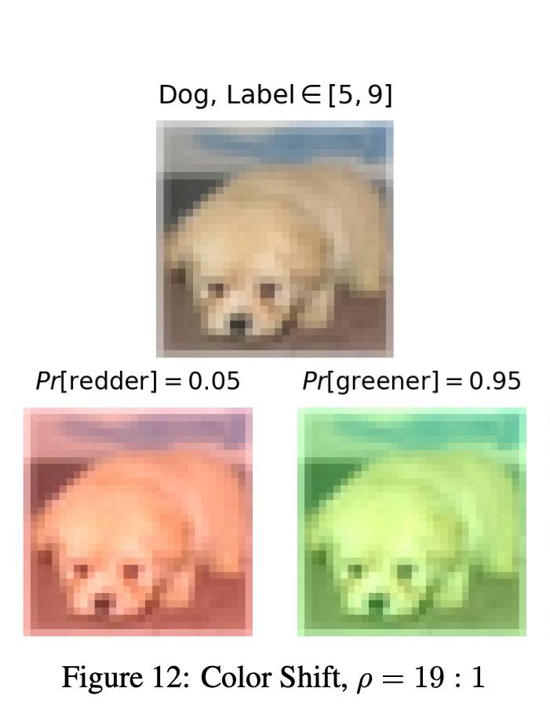
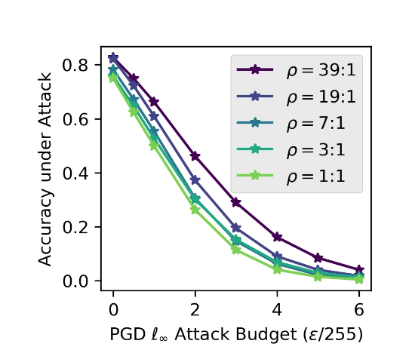
Empirical Evidence with Deep models
Presence of Spurious Correlations Can Improve Adversarial Robustness
The majority group consists of red-shifted images from classes 0−4 and green shifted images from classes 5 − 9, while the minority group has reverse color-shifts
Figure 10) CIFAR10 red/green shifted
Figure 11) Reverse Effect

Slide 26
THank You!

Slide 27
Questions?

Slide 28
$$X$$
$$θ$$
$$θ^{opt}$$
1
1
$$\{$$
1
2
2
$$C≠0$$
2
$$⟨$$
3
3
$$⟩$$
$$W$$
3
.
.
.
$$,$$
.
.
.
$$+$$
1
.
.
.
$$\{$$
$$S=0$$
m
m
m

Slide 29
Spurious
Core

Slide 30
Paper Organization
In a linear regression model, it has been proven that the parameters ensuring adversarial robustness differ from those ensuring natural distributional robustness, which avoids reliance on spurious features.
In an example in the same setup as the theory, it has shown that reliance of a adversarially trained model on spurious features increases.
With empirical evidence on deep models it shows:
(Effect) Adversarial training reduces core and increases background reliances
(Reverse Effect) Presence of Spurious Correlations Improves Adversarial Robustness

